Slide 1
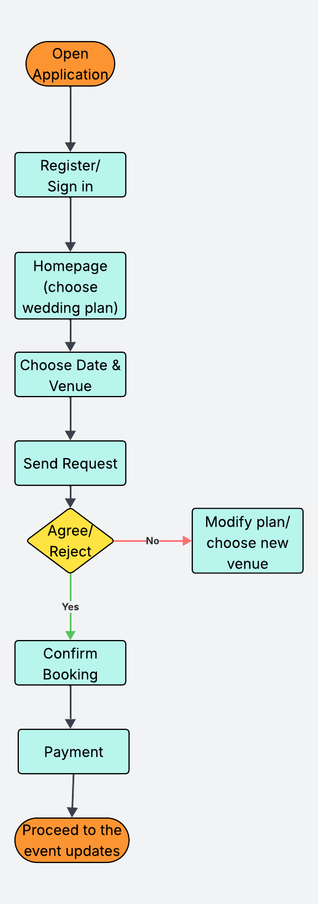
BPMN Model Using Lucidchart

Slide 2
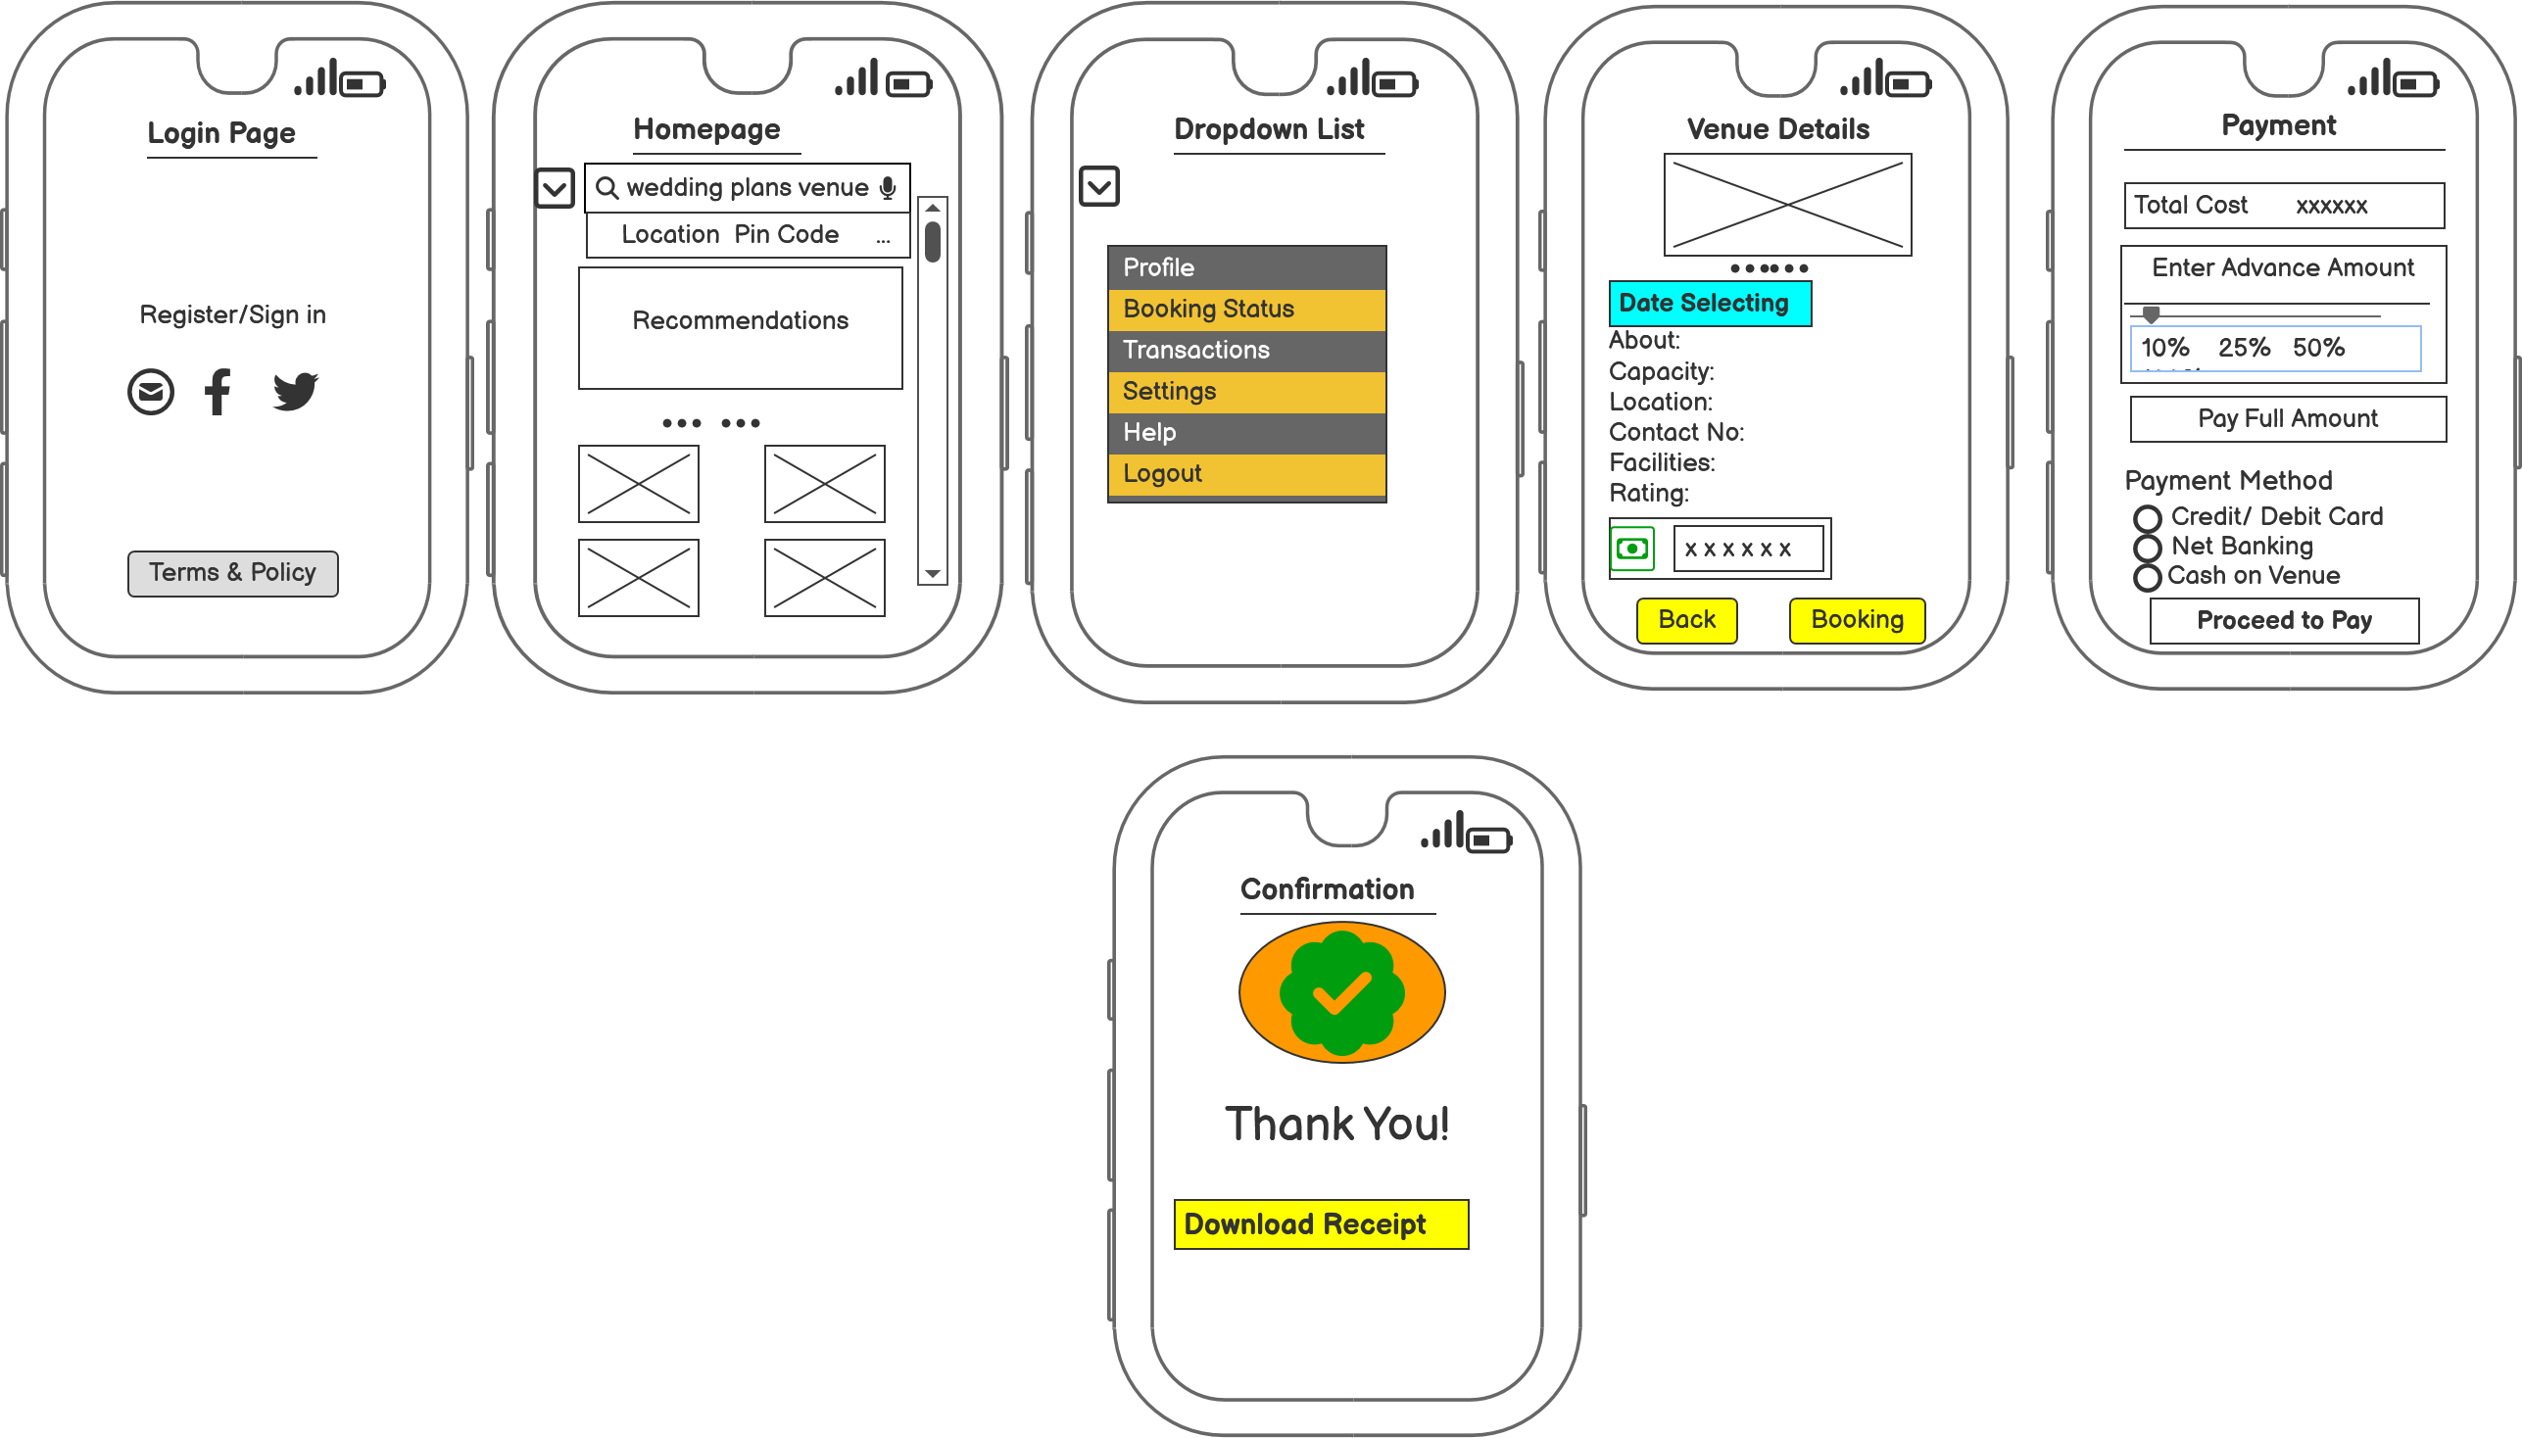
WireFrame Design with Balsamiq

